Slide 1
Time Series: Autoregressive models ARIMA-Part3
1 / 77

Slide 2
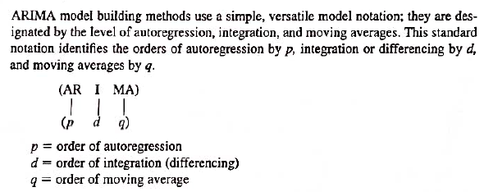
ARIMA Notation – p,d,q

Slide 3
ARIMA
.
An ARIMA model is one where the time series is differenced at least once to make it stationary and you combine the AR and the MA terms

Slide 4
AR
Pure Auto Regressive (AR only) model is one where Yt depends only on its own lags. That is, Yt is a function of the ‘lags of Yt’.

Slide 5
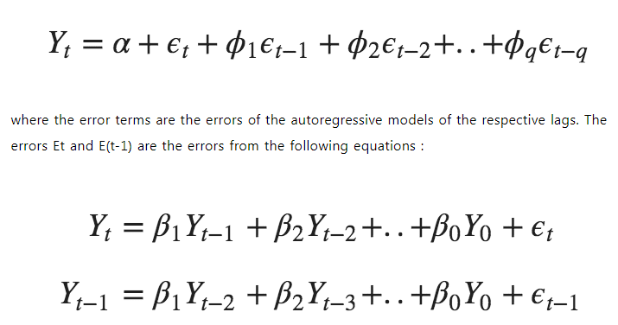
MA
A pure Moving Average (MA only) model is one where Yt depends only on the lagged forecast errors

Slide 6
ARIMA
.
Predicted Y_{t} =
Constant +
Linear combination Lags of Y (up to p lags) + Linear Combination of Lagged forecast errors (up to q lags)

Slide 7
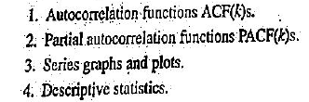
ARIMA MODEL IDENTIFICATION
.
Tools employed:

Slide 8
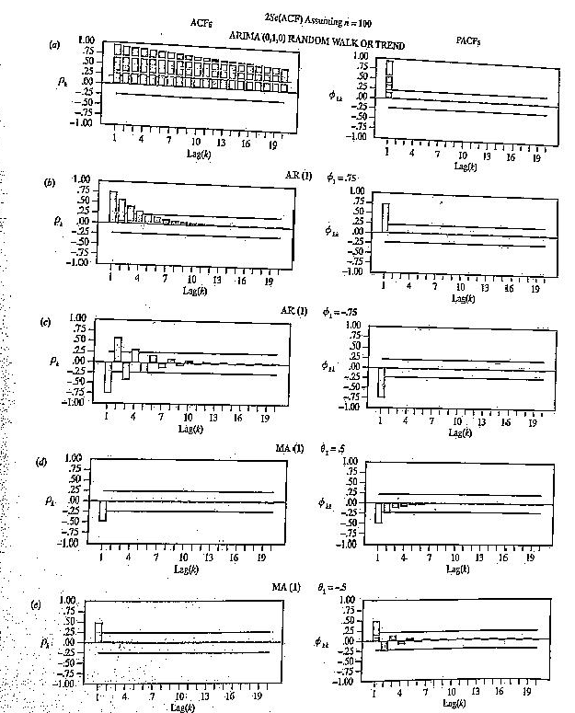
ARIMA: ACF and PACF
.

Slide 9
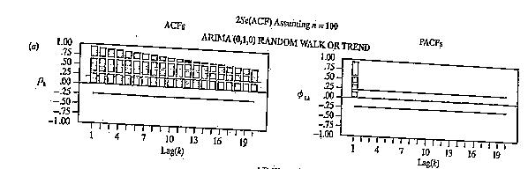
ARIMA (0,1,0) (Random Walk and Trend)
.
Non-stationary series…linear decline of ACFs
High significant ACFs, decline slowly

Slide 10
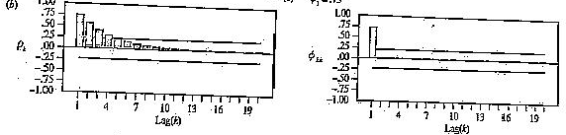
ARIMA (1,0,0) AR
.
Similar to Random Walk, but ACFs decline exponentially
Single PACF for lag1 and two for Lag2

Slide 11
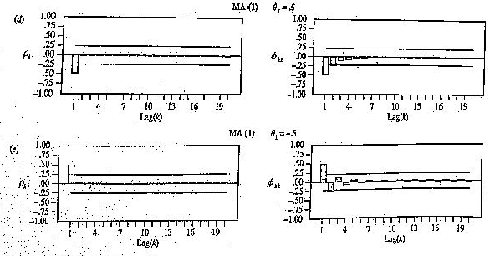
ARIMA (0,0,1) Moving Average (MA) Models
.
ACF has a single spike (up or down)
PACF decline exponentially

Slide 12
ARIMA ACF and PACF of White Noise
.
The ACF and PACF of White Noise are Pattern-less.
No statistically significant ACF or PACF

Slide 13
ARIMA: Characteristics of a good Forecasting Model
.
Fits past data well
Plots of actual Vs fitted are good
R square is high
Low RES
MAPE is good
Model has intuitive appeal
Parsimony, not having too many coefficients
Model is Stationary
Statistically sig coefficients
No patterns left in ACFs and PACFs
Residuals are white noise ( or have no patterns)
Bayesian Information Criteria(BIC) and Akaike Information Criteria(AIC) are lower than those of other models under consideration

Slide 14
Time Series Examples
.

Slide 15
ARIMA (0,0,0) Model For White noise
.

Slide 16
White Noise
What is a White Noise Time Series?
A time series is white noise if the variables are independent and identically distributed (iids) with a mean of zero.
This means that
all variables have the same variance (sigma^2) and
each value has a zero correlation with all other values in the series

Slide 17
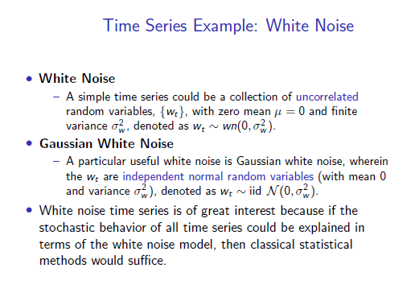

Slide 18
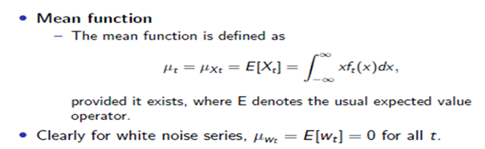
Mean for White Noise

Slide 19
Example – Model ARIMA (0,1,0) for Random Walk and Trends
.

Slide 20
Random Walk
A random walk is another time series model where the current observation is equal to the previous observation with a random step up or down.

Slide 21
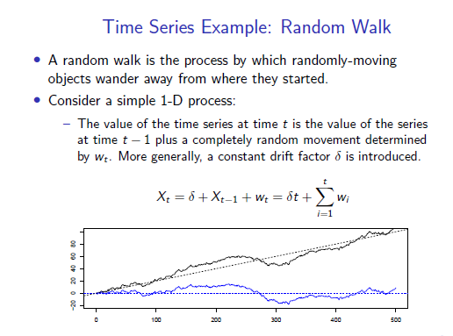

Slide 22
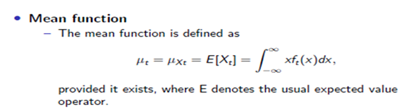
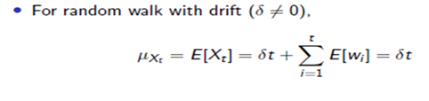
Mean for Random Walk

Slide 23
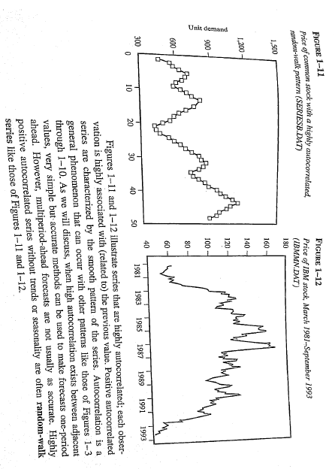
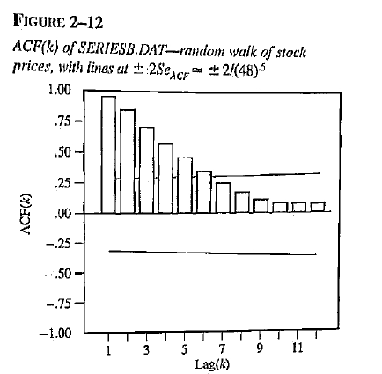
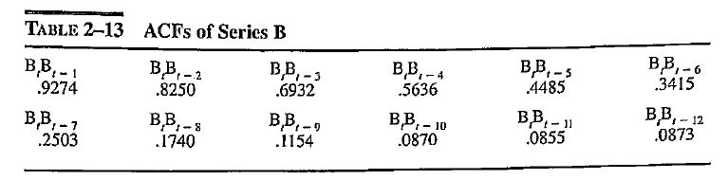
Pattern Recognition with ACFs (Random Walks) – randomly walks above and below its overall mean)
Highly auto-correlated
Correlated with preceding value
ACF

Slide 24
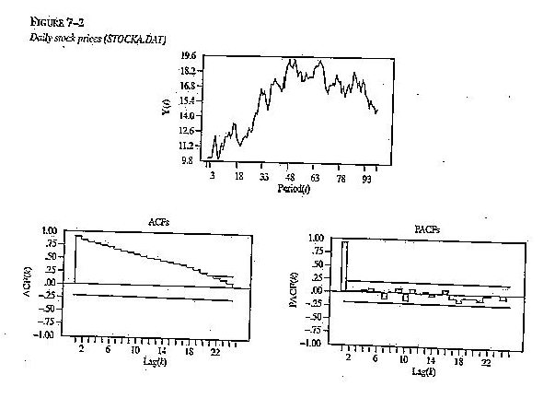
ARIMA (0,1,0) Random Walk Model
Depicts daily stock prices traded on an exchange

Slide 25

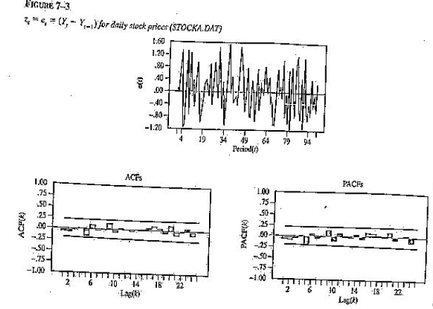
ARIMA (0,1,0) Random Walk Model
The previous value seems to be the best forecast
Differences have a mean of zero and are distributed as white noise

Slide 26
Example – Model ARIMA (1,0,0) For an Autoregressive Time Series
.

Slide 27
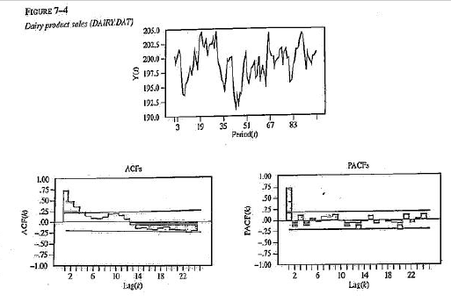
Model ARIMA (1,0,0) For an Autoregressive Time Series
Daily product sales for 100d period
Some wandering about mean of 199.02
ACFs show exponential decline
PACF has a single spike at 1
=> Suggest an Autoregressive model ARIMA(1,0,0)
Residuals-see next slide

Slide 28
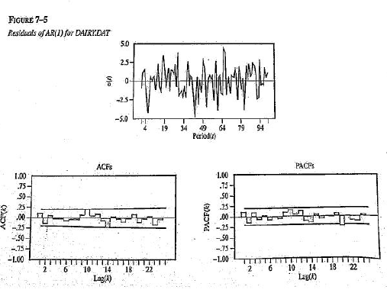
Model ARIMA (1,0,0) For an Autoregressive Time Series

Slide 29
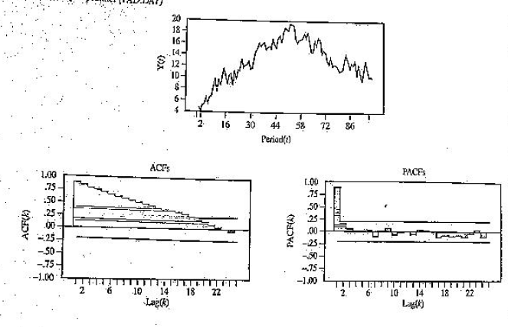
Model ARIMA (0,1,1)
For a MA Time Series after taking first differences
Series:
Initially a non-stationary series
ACF and PACF also indicate non-stationary status
Two components in model: (1)Integrated(I) and (2)Moving Average(MA)
Hence ARIMA(0,1,1)

Slide 30
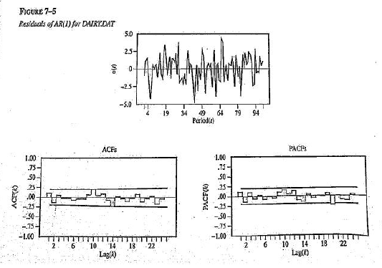
Model ARIMA (0,1,1) Step1:Residuals of Time Series after taking first differences ( d = 1)

Slide 31
Model ARIMA (0,1,1) Step1:Residuals of Time Series after taking first differences
The first difference has a stationary mean
Single peak in ACF and negative exponential decline in PACF are indicative of a MA Model (not very clear in Fig)

Slide 32
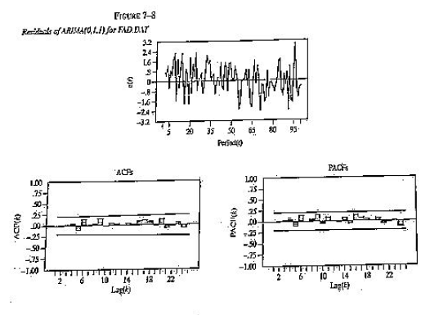
Model ARIMA (0,1,1) Step2: Residuals of MA Time Series after taking first differences => in all ARIMA(0,1,1)
The graph of residuals appear to be random
Implies our 2 step process of d=1 first followed by q=1 i.e., (0,1,1) captured the series

Slide 33
Thank You
33 / 77

